Slide 1

Introduction to Artificial Intelligence Group 1 Week 4
Dr. Juan Carlos Rojas
Juan-Carlos.Rojas@ttu.edu

Slide 2
Schedule
Date | Class | HW Assigned | HW Due
May 18 | Class 1 | HW1
May 25 | Class 2 | HW2 | HW1
June 1 | Class 3 | HW3 | HW2
June 8 | Class 4 | HW4 | HW3
June 15 | No class
June 22 | Class 5 | HW5 | HW4
June 29 | Class 6 | HW6 | HW5
July 6 | Class 7 | HW7 | HW6
July 13 | Class 8 |  | HW7

Slide 3
Agenda for Week 4
Theory
Multinomial Classification
Label encoding
One-vs-others classification
Softmax function
Quality metrics
Image Classification
Pixel mapping
Interpretation of model coefficients
Resolution
TensorFlow
TensorFlow basics
Matrix operations
Gradient computations
Practice
MNIST dataset
Exploration
Pre-processing
Naive Bayes classification
Linear regression classification
Logistic regression classification
Random forest classification
Tensorflow
Solving Normal equations
Gradient descent
Logistic regression
Softmax regression

Slide 4
Multinomial Classification

Slide 5
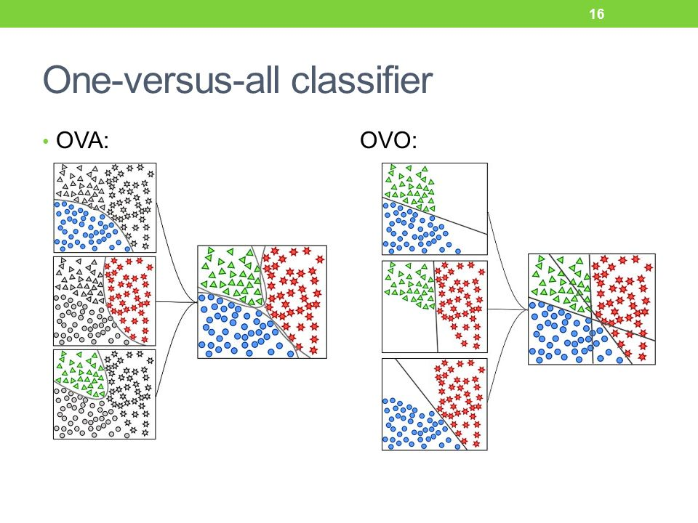
Multinomial Classification
Classification into 3 or more classes
Mutually exclusive
Also known as multiclass classification
Some classifiers can handle multinomial classification directly
kNN, decision trees
Others need transformations to convert the problem into multiple binary problems

Slide 6
One-vs-Rest (OvR) Classification
You can convert a multinomial classification problem into several OvR problems
Each OvR classifier is binary
Predicts True/False with a confidence score (i.e. prediction probability)
The classifier with highest confidence wins
This approach is not guaranteed to be correct
It may be affected by class imbalance

Slide 7
One-vs-One (OvO) Classification
Trains one binary classifier for every combination of two classes
The winner of each classifier gets a vote
The class with more votes is the overall winner
Can have ambiguous results in cases of vote count ties

Slide 8
Multinomial Cost-Function Minimization
For models trained through gradient descent
You can define a cost function that takes into account all possible classes
Minimizing the cost function results in a globally optimal choice
This works well for multinomial Logistic regression
a.k.a. Softmax regression

Slide 9
Hand-Written Digit Database (MNIST)

Slide 10
MNIST Database
Database of hand-written digits
A classic example used in machine learning courses
From http://yann.lecun.com/exdb/mnist/
10 classes (digits 0-9)
Training set: 60,000 images
Test set: 10,000 images
Images:
28x28 pixels
Grayscale
Digits have been size-normalized to 20x20 and centered according to the center of mass

Slide 11
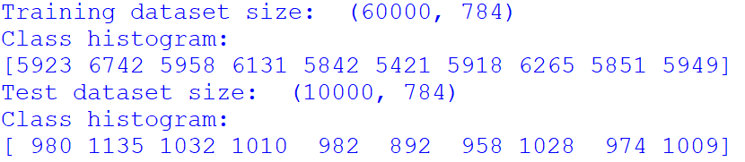
Reading and Exploring the Data
The MNIST database comes in four binary files that follow a proprietary format
We need a helper function to unpack the data
Each image is “unwrapped” as a single vector of 784 elements
Each pixel is treated as an independent variable
Label class histogram:
The 10 classes are reasonably well balanced
See Mnist_Explore_1.py

Slide 12
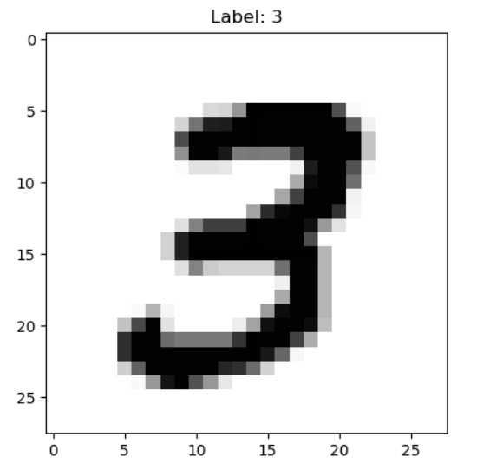
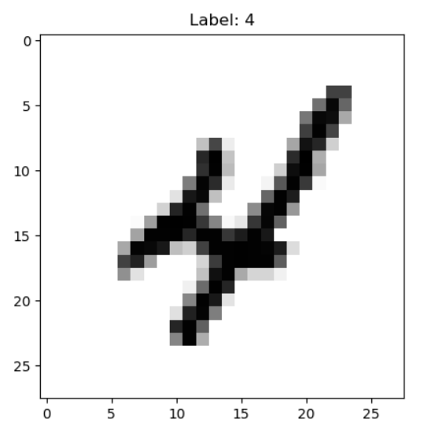
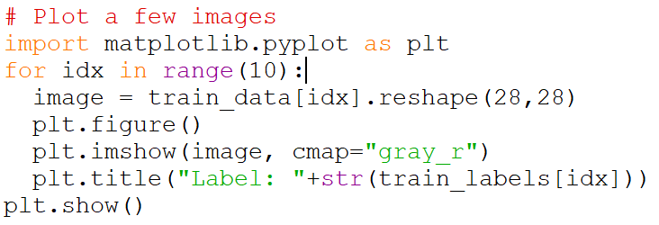
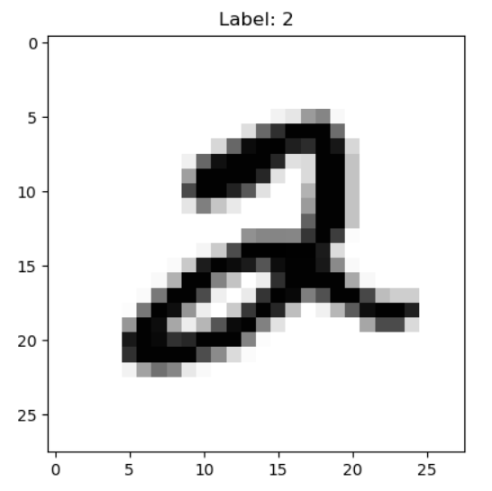
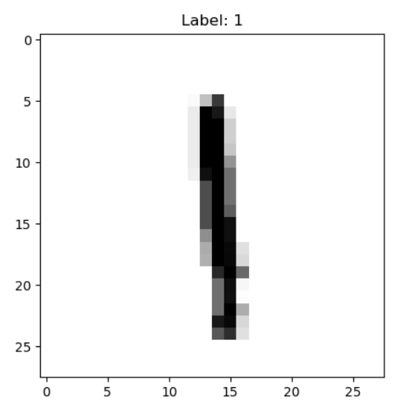
Viewing the Images
Each row needs to be “reshaped” into a 28x28 image
Using a reverse gray color map helps visualize
See Mnist_Explore_1.py

Slide 13
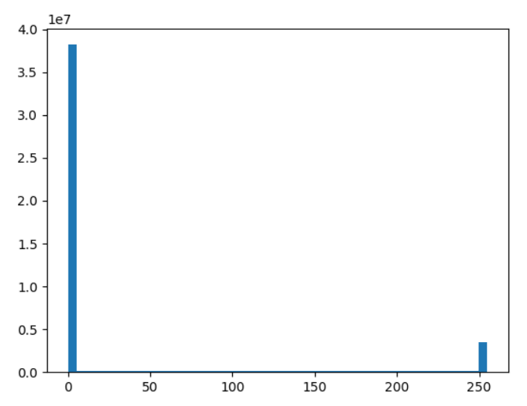
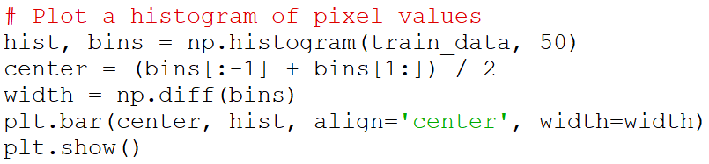
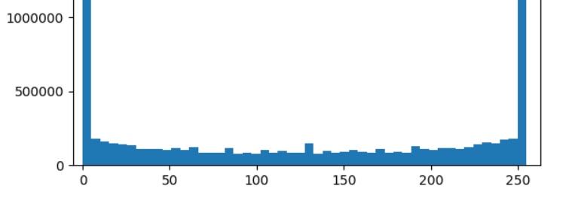
Pixel Values
Pixels are mostly black (0) and white (255)
A few gray values are present, but not many
See Mnist_Explore_1.py

Slide 14
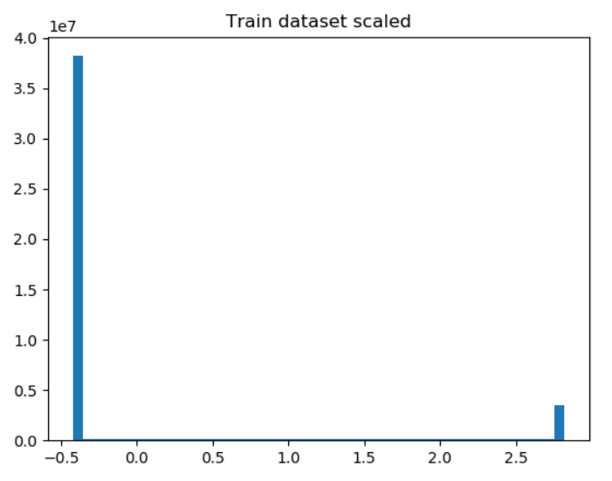
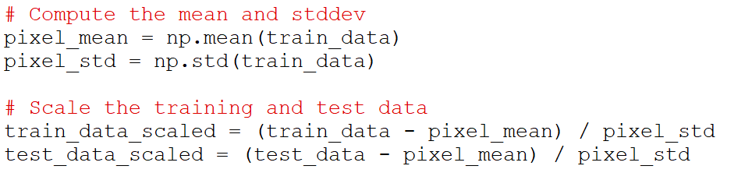
Pixel Normalization
We want to use a single scaling for all pixels, to keep them consistent
Can’t use StandardScaler
It works on each feature independently
It would amplify noise
We can do it manually:
To save disk space, we will not save the scaled data
We will scale it every time we use it
See Mnist_Prepare.py

Slide 15
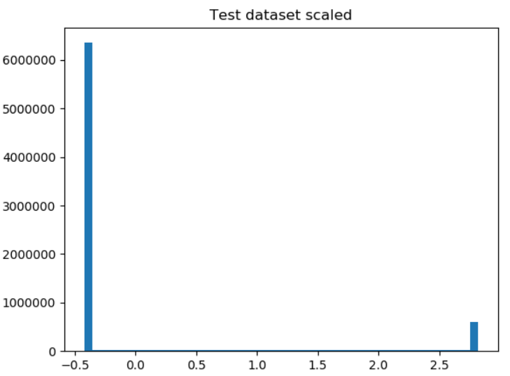
Practice 1
Load the MNIST dataset unscaled pickle file (mnist_dataset_unscaled.pickle)
Apply standardization of the pixel values
Remove the mean, and divide by the standard deviation
Do it to both training and test data
Plot a histogram of all the pixel values
Do it for the training data, and for the test data
Plot the first 5 digits as images

Slide 16
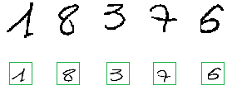
Geometric Normalization
In order to make our example digits as similar as possible, we want to scale and center them
The first step is to determine the bounding box of every digit
Then it is scaled to a standard size
For MNIST this is 20x20
Then the center of mass is computed
The geometric average of all the pixels
Then it is shifted so that the center of mass is in the center of the image
This requires extending the image size
For MNIST this is 28x28
The MNIST dataset already comes with this done

Slide 17
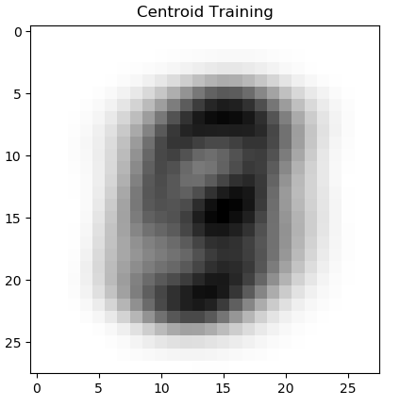
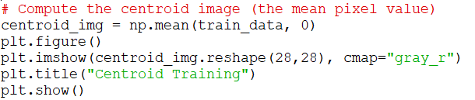
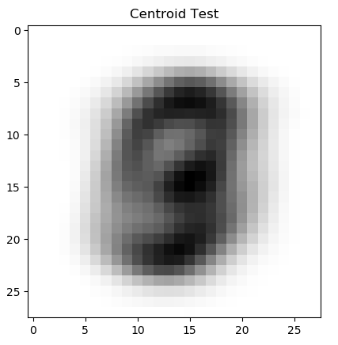
Viewing the Geometric Distribution
We can aggregate all the input images together to see how well they line-up
This is an image of pixel centroids
It is interesting to observe which pixels are used the most
We can also display the centroid image of the test set, to make sure it is consistent
See Mnist_Explore_3.py

Slide 18
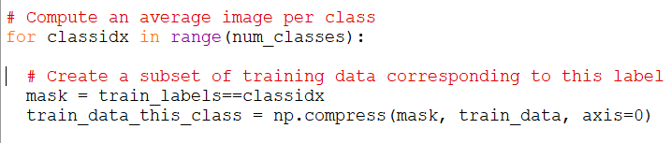
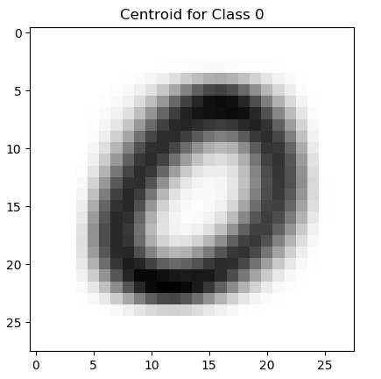
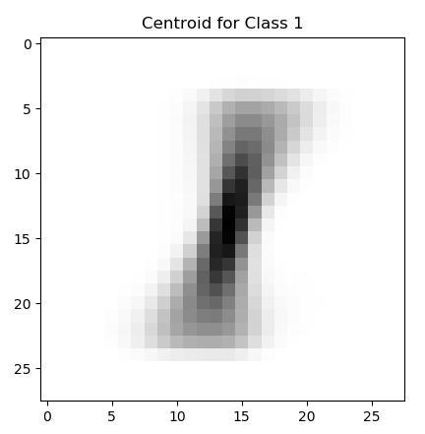
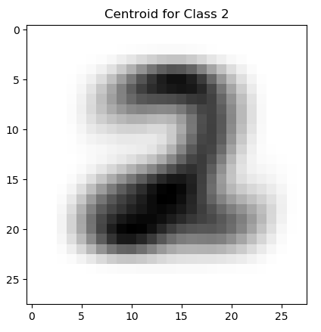
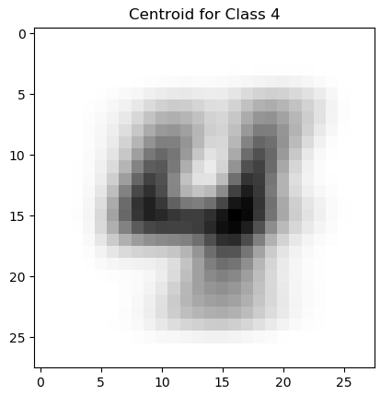
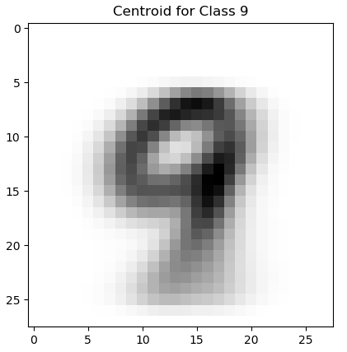
Centroids per Class
We can also explore the mean pixels values but limited to each class
We can create a subset of the training data based on the labels
See Mnist_Explore_3.py

Slide 19
Class vs. Feature Visualizations
Since there are 784 input features, visualizations require dimensional reductions
I highly recommend this excellent article about visualizing the clusters of data in the MNIST database
https://colah.github.io/posts/2014-10-Visualizing-MNIST/

Slide 20
Probabilistic Classification

Slide 21
Interpreting the Centroid Images
The centroid image represents the probability that a given pixel is used in the entire dataset: p(x)
The darker areas are the pixels that are more likely to be used in digits

Slide 22
Interpreting Centroid Images
The centroid image for a given class C_{k} represents the conditional probability that a given pixel is used, given that the class is C_{k} : p(x | C_{k} )

Slide 23

Class Probabilities
Applying Bayes theorem we can estimate the probability of belonging to class C_{k} given the pixels x as
We already have p(x) and p(x | C_{k} )
The probability of every class p(C_{k}) represents how likely is each class to be used
Can be derived from the count of labels per class
Let’s assume they are all equal for now, so we ignore this factor
We can compute p(C_{k} | x) by dividing the class centroid image by the overall centroid image

Slide 24
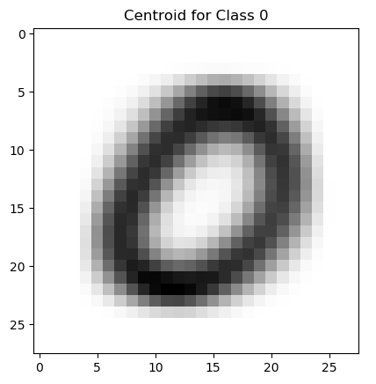
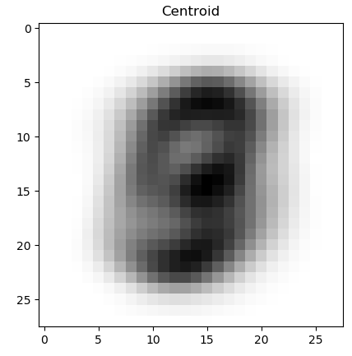
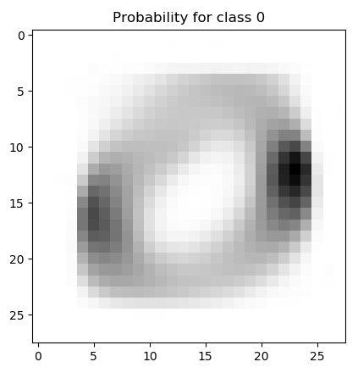
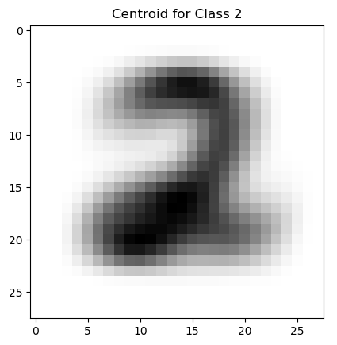
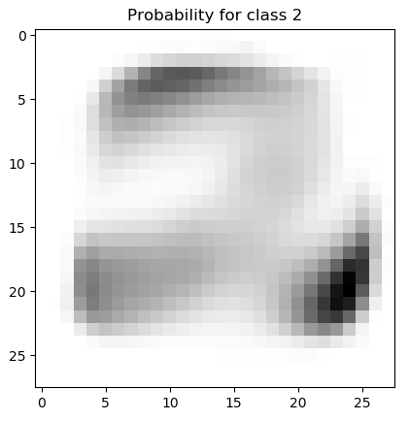
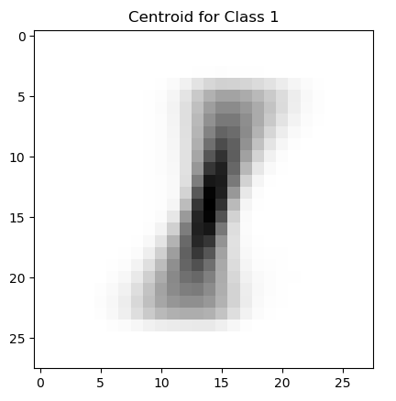
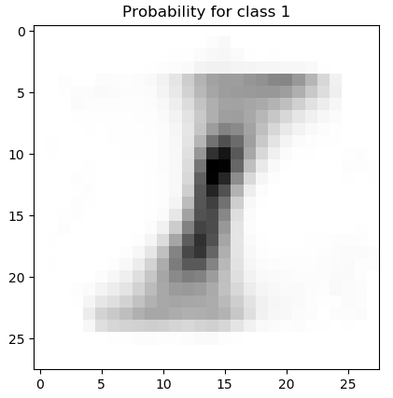
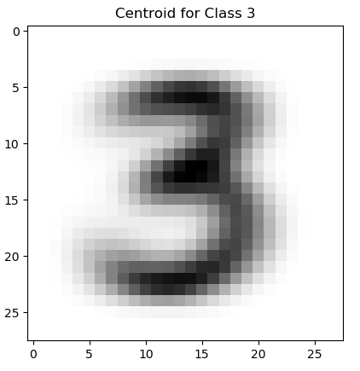
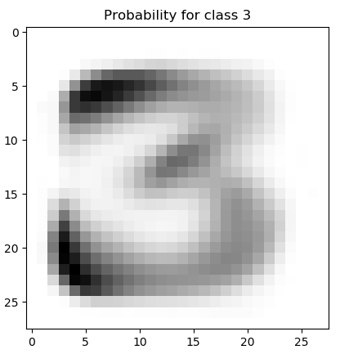
Class Probability Images
We divide each class centroid image by the overall centroid image
Pixels with zero in the denominator were forced to zero
/
=
/
=
/
=
/
=
See Mnist_NaiveBayes_1.py

Slide 25
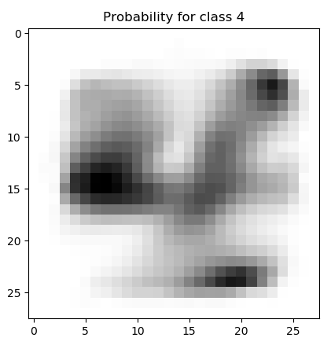
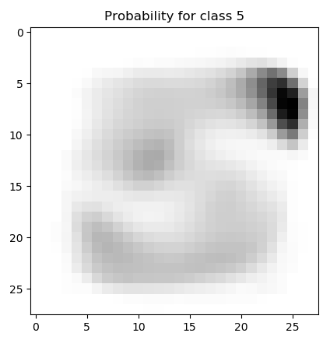
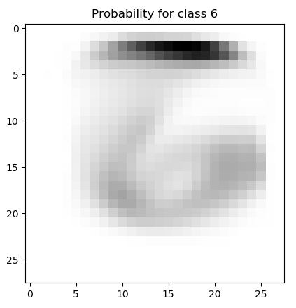
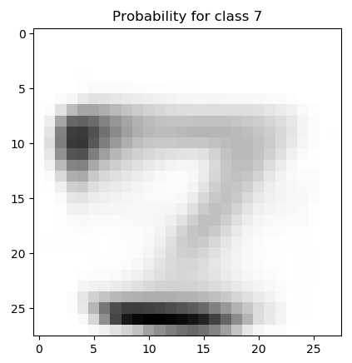
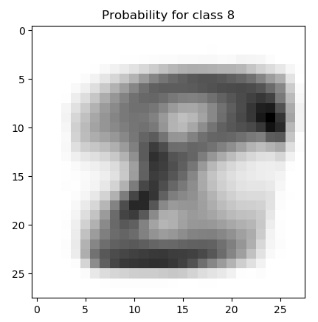
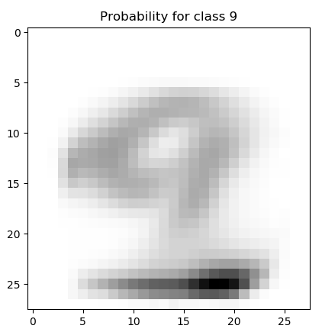
Class Probability Images
Each pixel in these images represent the probability of belonging to the class, given that the pixel is used in the test image
See Mnist_NaiveBayes_1.py

Slide 26
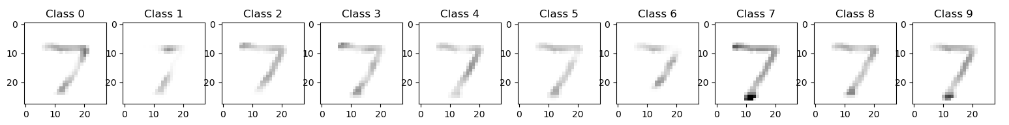
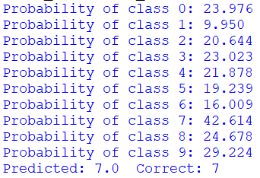
Naive Bayes Classifier
We can use the probability images as a basis for a classifier
We take each test image, multiply each pixel by the probability image of each class, then add* the probabilities of all pixels
Assumes all pixels are independent
*To be mathematically correct, all the individual pixel probabilities should be multiplied together, not added. But that would be very slow and tricky for cases with zeros. This is a variant of the formal Bayes classifier.
See Mnist_NaiveBayes_2.py

Slide 27
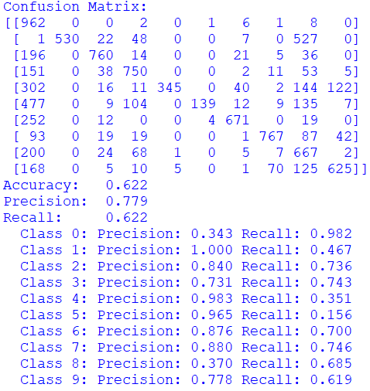
Quality Metrics
The confusion matrix now is 10x10
Correct predictions are on the diagonal
Off-diagonal are false classifications divided by class
Overall accuracy is 62%
Not great
Per-class precision & recall are interesting
Precision for 1 is very good
Recall for 5 is very bad
See Mnist_NaiveBayes_3.py

Slide 28
Optional HW Problem 1b
Repeat the Naive Bayes classifier taking into account class imbalance
Based on Mnist_NaiveBayes_3.py
Compute the probability of every class p(C_{k})
From the counts of labels in the training set
Use these factors to scale the probability images of every class
Did results improve?

Slide 29
Multinomial Linear Regression

Slide 30
Label Encoding
If the output labels were names, they would need to be assigned numbers
Can use sklearn.preprocessing.LabelEncoder
In this case, the labels are already numbers from 0-9
Some classifiers can handle multinomial labels directly
Others need to be split into multiple OvR/OvO classifiers
We will use OvR
Separate the labels into 10 one-hot-encoded labels
Can use sklearn.preprocessing.OneHotEncoder

Slide 31

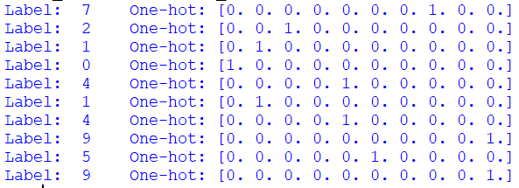
One-Hot Label Encoding
See Mnist_LinearRegression_1.py

Slide 32
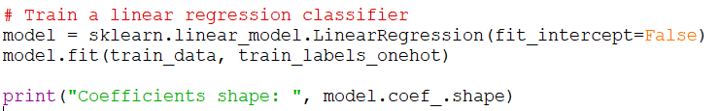
Linear Regression OvR Classifier
Since there are 10 columns in the output vector, this trains 10 classifiers, one for every label class
There are 784 coefficients for each of the 10 classifiers
See Mnist_LinearRegression_1.py

Slide 33
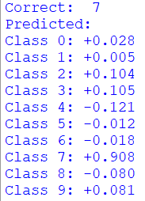
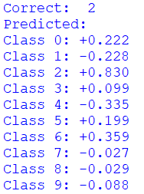
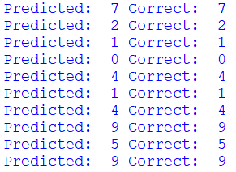
Label Predictions
The model will produce 10 prediction probability values
One for every class
We need to pick the largest
See Mnist_LinearRegression_1.py

Slide 34
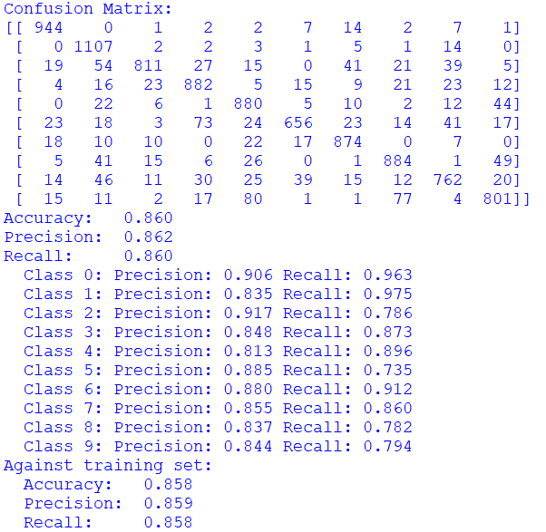
Quality Metrics
Decent results
Accuracy, precision & recall are all similar
Against training set too, which suggest underfitting
Per-class precision & recall:
Recall for 5 is a bit lower
See Mnist_LinearRegression_2.py

Slide 35
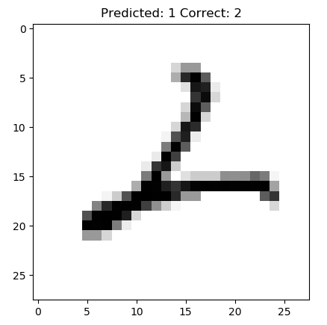
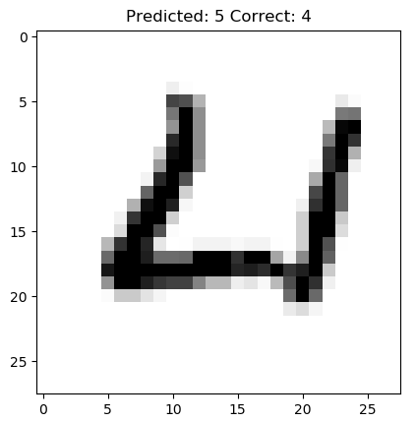
Practice 2
Load the MNIST unscaled pickle file (mnist_dataset_unscaled.pickle)
Scale the training and test data
One-hot encode the labels
Train a linear regression classifier
Compute the predicted labels for the test data
Compute and print the accuracy score
Display 10 images of digits that were predicted incorrectly
Show the predicted and correct labels

Slide 36
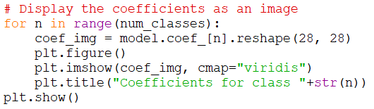




Viewing Coefficients
We can convert the coefficients into an image and view it
The largest coefficients are at the top edge
Not where expected
There are very large coefficients
But most are close to zero
See Mnist_LinearRegression_3.py

Slide 37


Viewing the Coefficients
If we limit the range of values displayed (letting it saturate), we can see a bit of the patterns
But it is still counter-intuitive
See Mnist_LinearRegression_3.py

Slide 38





Adding Background Noise
Helps avoid artificially large coefficients due to pixels that are always zero
There are still many large coefficients on the edges
Adding more noise reduces this effect, but reduces accuracy
See Mnist_LinearRegression_4.py

Slide 39





Ridge Regression
A variant of linear regression that imposes penalties on large coefficients
The coefficients are nicely distributed without the need for noise
Results are very similar to Linear Regression with noise
See Mnist_RidgeRegression_1.py

Slide 40



Lasso Regression
Another variant of linear regression that tends to produce few non-zero coefficients
Trained by gradient descent (slower)
It has a regularization parameter α that we can tune
Uses a lot less non-zero coefficients
Closer to where we expect them
Results are worse:
See Mnist_LassoRegression_1.py

Slide 41



Elastic Net Regression
Yet another variant of linear regression
Behaves a bit like Lasso and Ridge combined
Has two tuning parameters α and l1_ratio
Generates more coefficients than Lasso, not as many as Ridge
Results are comparable with LinearRegression
See Mnist_ElasticNetRegression_1.py

Slide 42

Break
Back at

Slide 43
Multinomial Logistic Regression (Softmax Regression)

Slide 44

The Softmax Function
An extension of the Logistic function to multiple outputs
Each output will be in the range [0, 1]
Ensures that they all add-up to 1
The outputs can be considered probabilities

Slide 45

Softmax Regression
Minimizes an overall cost function that has one component for every possible class
Minimizing this cost function results in an optimal class choice
Used in gradient descent

Slide 46

Softmax Regression in Scikit-Learn
The LogisticRegression can be used for Softmax regression
Set the parameter multi_class = “multinomial”
No need to do one-hot encoding of labels
Need to use a stochastic gradient descent solver (a.k.a. “sag”)
Need to adjust the convergence tolerance and limit the iterations
Otherwise it is too slow
See Mnist_LogisticRegression_1.py

Slide 47

Softmax Regression
Significantly better than linear regression
See Mnist_LogisticRegression_1.py

Slide 48




Exploring the Coefficients
The coefficients are nicely distributed
Their locations make sense
See Mnist_LogisticRegression_1.py

Slide 49
Practice 3
Repeat the example in Mnist_LogisticRegression_1.py but use OvR classifications instead of multinomial optimization
Is it easier or harder to converge?
Are the results the same, better or worse?

Slide 50
Decision Trees & Random Forests

Slide 51

Decision Trees
Decision trees can handle multinomial classification directly
We can use it to tune min_samples_leaf
Selected:
min_samples_leaf=5
See Mnist_DecTree_1.py

Slide 52

Random Forest
Results get a lot better with random forests
With:
n_estimators=100
min_samples_leaf=5
Nice!
See Mnist_RandForest_1.py

Slide 53




Viewing Mis-Classifications
Getting cases that are vague
See Mnist_RandForest_1.py

Slide 54

Pixel Importance
From the random forest, we can obtain the feature importances
These represent the relative importance each pixel has in the classification
We could use this to mask-off unimportant pixels
Feature pruning for images
See Mnist_RandForest_2.py

Slide 55
Reference Classification Results for MNIST
From http://yann.lecun.com/exdb/mnist/
Algorithm | Accuracy
Linear Regression | 88.0%
kNN | 97.27%
SVM | 98.6%
6-Layer NN | 99.65%
Convolutional NN | 99.65%

Slide 56
Image Resolution

Slide 57
Effect of Image Resolution on Classification
It is interesting to study the effects of reducing the image resolution on classification results
We can resample the images to different sizes and re-run the classifiers

Slide 58

Resizing Images
We can use scikit-image to resize the input images
As a pre-processing step
See Mnist_Resize_1.py

Slide 59





Resizing Images
We can visualize some of the images
20x20
16x16
12x12
8x8
4x4
See Mnist_Explore_4.py

Slide 60
Effect of Image Resolution on Classification
Using random forests (n_estimators=100, min_samples_leaf=5)
Resolution | Test Accuracy
28x28 | 0.965
24x24 | 0.966
20x20 | 0.963
16x16 | 0.963
12x12 | 0.961
10x10 | 0.958
8x8 | 0.949
6x6 | 0.931
4x4 | 0.881
See Mnist_RandForest_1.py

Slide 61
Optional HW Problem 3b
Study the effects of image resolution on Softmax regression classification accuracy
Create scaled datasets at various resolutions
Run a softmax regression classifier on each of the sets
Note the prediction accuracy of each data set
Compare the results with the behavior observed with random forest classifiers

Slide 62
TensorFlow

Slide 63
TensorFlow
A generic computation framework developed by Google
You first create a description of the computation
Then you execute it
The framework of choice for neural networks
Maps well to GPUs
Requires special installation
Can map to clusters of computers

Slide 64


TensorFlow Example 1
See TensorFlow_Example_1.py

Slide 65

Solving Normal Equations in TensorFlow
We can operate in vectors and matrices in TensorFlow
For example, we can solve the Normal equations
See VehiclePrice_LinearRegression_tf_1.py

Slide 66

Practice 4
Use Tensorflow to solve the Normal equations of a linear regression model of vehicle prices
See VehiclePrice_LinearRegression_tf_1.py
Add TensorFlow instructions to compute the prediction values against the test dataset
Print the first 10 prediction values
Compare with the first 10 correct label values

Slide 67
Solving Gradient Descent in TensorFlow
We can solve linear regression coefficients by gradient descent
Algorithm:
Define the input vectors for X and Y
Initialize the vector of coefficients to random values
Compute the prediction Y_pred = X * W
Compute the MSE
Compute the gradient of the MSE w.r.t. each feature
Update the coefficients as W - learning_rate * gradients
Repeat 3-6 until converged, or after a given number of iterations
This is considered a batch approach
We are using all available data at every iteration

Slide 68
Computing Gradients
There are several methods
Numerical differentiation
Symbolic differentiation
Forward-mode automatic differentiation
Computation is broken down into basic arithmetic operations whose derivative is known
Chain-rule is used to compute the numerical result
Reverse-mode automatic differentiation
The same, but working from the output backward to the input
Saves computations when there are few outputs
TensorFlow uses reverse-mode auto-diff
Fast & accurate when there are many inputs and few outputs
Recommended reading:
https://www.cs.toronto.edu/~rgrosse/courses/csc321_2018/slides/lec10.pdf

Slide 69
Solving Gradient Descent in TensorFlow
Define the input vectors for X and Y
Initialize the vector of coefficients to random values
Compute the prediction Y_pred = X * W
Compute the MSE
See VehiclePrice_LinearRegression_tf_2.py

Slide 70

Solving Gradient Descent in TensorFlow
Compute the gradient of the MSE w.r.t. each feature
Update the coefficients as W - learning_rate * gradients
Repeat 3-6 until converged, or after a given number of iterations
See VehiclePrice_LinearRegression_tf_2.py

Slide 71

Solving Gradient Descent in TensorFlow
The algorithm gradually reduces the MSE
It takes a few 1000s of iterations to converge
Depends on the learning rate
See VehiclePrice_LinearRegression_tf_2.py

Slide 72


Solving Gradient Descent in TensorFlow
The coefficients can be retrieved by running a session for them:
The training RMSE is obtained from the MSE measurement we already have
See VehiclePrice_LinearRegression_tf_2.py

Slide 73

Using Optimizers
We can use a built-in gradient descent optimizer
Replaces steps 5 & 6 of the previous list
The results are the same
Runs a little bit faster
There are other optimizers (i.e. Adagrad, momentum)
See VehiclePrice_LinearRegression_tf_3.py

Slide 74



Using a Bias Variable
Instead of adding a column of ones, we can use a separate variable for the intercept
We will call it bias
The results are exactly the same as before
W has one less coefficient, which is now in b
See VehiclePrice_LinearRegression_tf_4.py

Slide 75

Practice 5
Use Tensorflow to to solve a linear regression model for vehicle prices using gradient descent
You can base it on VehiclePrice_LinearRegression_tf_4.py
Add Tensorflow instructions to compute the RMSE of the test predictions against the test labels

Slide 76
Optional HW Problem 5b
Adjust the learning rate in the gradient descent solution of the vehicle price linear regression
What happens if the learning rate is very large?
What happens if it is very small?

Slide 77

Implementing Logistic Regression in TensorFlow
We use the same gradient descent approach
We use the same vectors to represent coefficients and bias
We add a sigmoid function to the prediction
See CreditDefault_LogisticRegression_tf_1.py

Slide 78

Implementing Logistic Regression in TensorFlow
For the cost function, we use a built-in TensorFlow cross-entropy function
It includes the sigmoid function, so we pass-in only the linear portion
See CreditDefault_LogisticRegression_tf_1.py

Slide 79




Implementing Logistic Regression in TensorFlow
It converges after a few 1000s of iterations
The prediction probabilities can be plugged-in to sklearn.metrics to evaluate classification results
See CreditDefault_LogisticRegression_tf_1.py

Slide 80


Softmax Regression in TensorFlow
Extending to multinomial cases is reasonably straightforward
The labels need to be one-hot encoded
We can continue to use sklearn.preprocess for this
The inputs are now matrices
See Mnist_LogisticRegression_tf_1.py

Slide 81


Softmax Regression in TensorFlow
The coefficients are now in matrix form (one row per class)
The biases are a vector (one per class)
We use the softmax version of the cost function:
See Mnist_LogisticRegression_tf_1.py

Slide 82

Softmax Regression in TensorFlow
Once optimized, we find the class with maximum probability
See Mnist_LogisticRegression_tf_1.py

Slide 83



Softmax Regression in TensorFlow
The gradient descent takes a while to run
Results are consistent with previous
Next step: stochastic training
See Mnist_LogisticRegression_tf_1.py

Slide 84
Thank you

